Slide 1
Career connect A Smart Placement & Internship Portal
PBL Group 29
Team Members : Ayush Butala Samyak Gaikwad Aadish Sonawane Siddhi Lolge Pratik Dhawale

Slide 2
Introduction
The placement and internship process is a crucial aspect of a student’s academic journey, bridging the gap between education and professional careers. However, many colleges struggle with organizing and managing this process efficiently. Students often find it challenging to discover relevant job and internship opportunities, while placement officers face difficulties in handling large amounts of data. To address these challenges, this project proposes a college-specific placement and internship platform that enhances the experience for both students and administrators.

Slide 3
PROBLEM STATEMENT
The placement and internship process in colleges is often disorganized, making it difficult for students to find relevant opportunities and for placement officers to manage data efficiently. This project aims to create a college-specific platform that recommends jobs and internships based on CGPA and skills, motivates students through a gamified leaderboard, and provides an admin dashboard for streamlined management.

Slide 4
MOTIVATION
The placement and internship process is often unstructured and stressful for students
Students struggle to find relevant job & internship opportunities efficiently
Placement officers have difficulty managing student data & company listings
Lack of motivation for students to improve coding skills and CGPA
Gamification techniques like leaderboards can boost engagement

Slide 5
Literature survey
Sr. no. | Paper Title | Year | Description
1. | Enhancing Job Recommendation Systems through Machine Learning | 2024 | • Supports AI-driven recommendations for better placements. • Helps refine job/internship suggestion algorithms. • Guides CGPA & skill-based matching.
2. | Using Internship Management System to Improve the Relationship between Internship Seekers, Employers, and Educational Institutions | 2020 | • Supports real-time company listings. • Enhances employer-student interaction. • Inspired tracking & application features.

Slide 6
Literature survey
3. | The Use of Leaderboards in Education: A Systematic Review of Empirical Evidence in Higher Education | 2024 | • Justifies the competitive ranking system. • Provides a framework for gamification features. • Defines success metrics for engagement.
4. | Examining the Effectiveness of Gamification as a Tool Promoting Intrinsic and Extrinsic Motivation Among Higher Education Students: A Systematic Review | 2023 | •Validates leaderboard-driven motivation. • Encourages skill improvement through competition • Supports long-term engagement strategies.

Slide 7
Objective
Create a web-based platform for college-specific internship & job recommendations
Provide a gamified ranking system to encourage skill development
Offer an admin dashboard for placement officers to manage recruitment efficiently
Help students make data-driven decisions about career opportunities
Increase student participation through leaderboards & performance tracking

Slide 8
Proposed Methodology
1. Data Collection
Gathering student profiles
Tracking CGPA and academic performance
Evaluating coding scores
2. Job Matching
Implementing AI-driven job recommendation algorithms
Mapping student skills to job requirements
Analysing employer expectations
3. Gamification
Introducing a leaderboard system
Tracking performance metrics
Enhancing engagement through interactive features
4. Deployment
Hosting on cloud platforms like AWS/GCP
Conducting scalability testing
Optimizing system performance

Slide 9
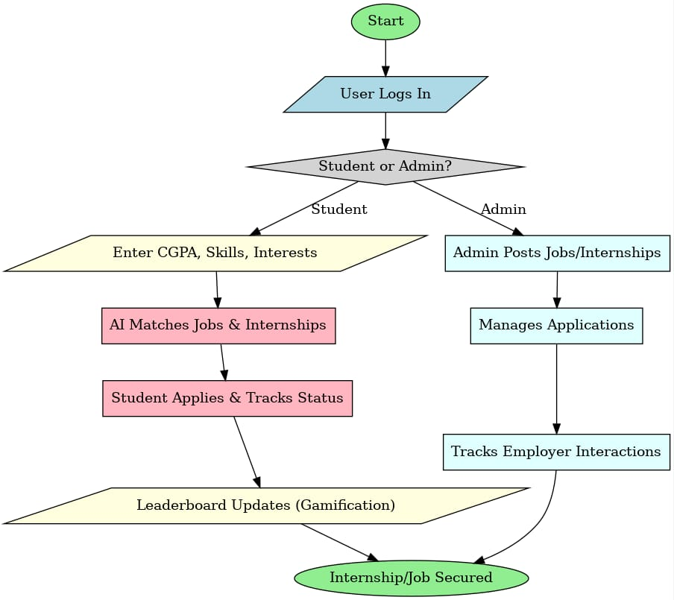
FLOWCHART

Slide 10
Expected benefits
For Students:
Easy access to internships and jobs based on CGPA and skills
Increased motivation through leaderboard rankings
Improved career planning with data-driven insights
For Placement Officers:
A centralized platform for managing students and companies
Simplified tracking of student performance and applications
For Companies:
Access to a filtered pool of qualified candidates
Efficient hiring through a dedicated recruitment panel

Slide 11
conclusion
Career Connect provides a structured, efficient, and engaging way to manage college placements & internships
Gamification & data-driven insights ensure students stay motivated and competitive
Placement officers get a centralized system to handle recruitment more efficiently

Slide 12
THANK YOU!

